Slide 1
BIG DATA TECHNOLOGIES
Final project: IoT integration
Presenter: Nha Doan, Nhat Pham

Slide 2
List of contents
Introduction of Big Data Technologies
Problems of IoT
Solution for IoT
Demonstration
Conclusion

Slide 3
Introduction
BIG DATA is a term used for a collection of data sets so large and complex that it is difficult to process using traditional applications/tools
BIG DATA TECHNOLOGIES are techniques which are used to store and analyse data
Examples of BDT:
MapReduce
Pig/Pig Latin
Hive
Sqoop
Flume
HBase
Spark
…

Slide 4
Problems of IoT
Nowadays, there are millions of devices equipped with sensors are connected together to communicate with each other in order to collect and exchange data. The phenomenon of daily life objects that are interconnected through a worldwide network is known as the Internet of Things (IoT) or Internet of Objects.
These sensors from a large number of devices or objects simultaneously and continuingly generate a huge amount of data, often referred to as Big Data. Handling this vast volume, and different varieties, of data imposes significant challenges when time, resources, and processing capabilities are constrained. Hence, Big Data Technologies become a good solution for data collection in IoT.

Slide 5
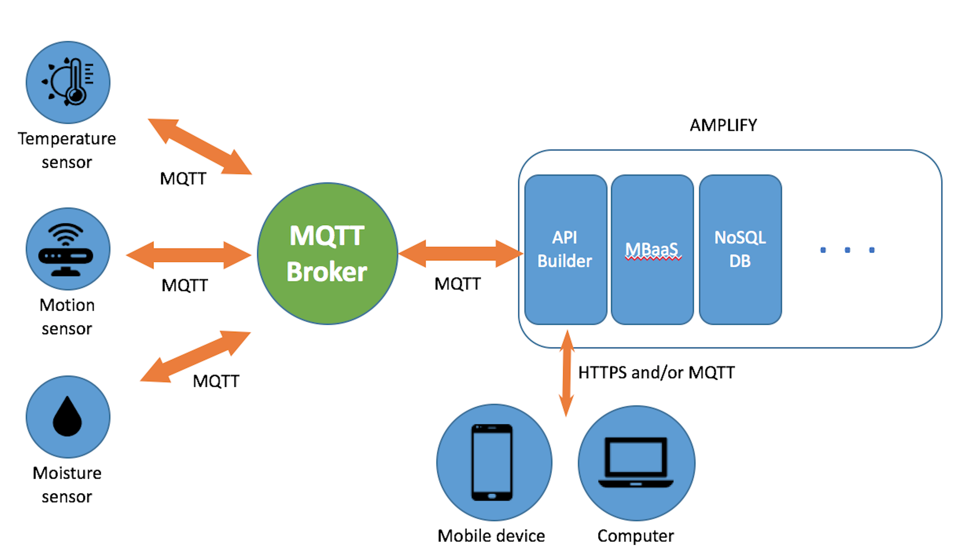
Solutions for IoT

Slide 6
Solutions for IoT

Slide 7
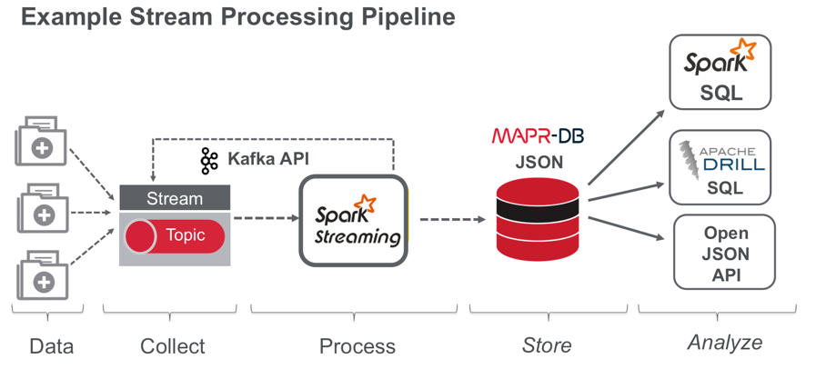
Solutions for IoT

Slide 8
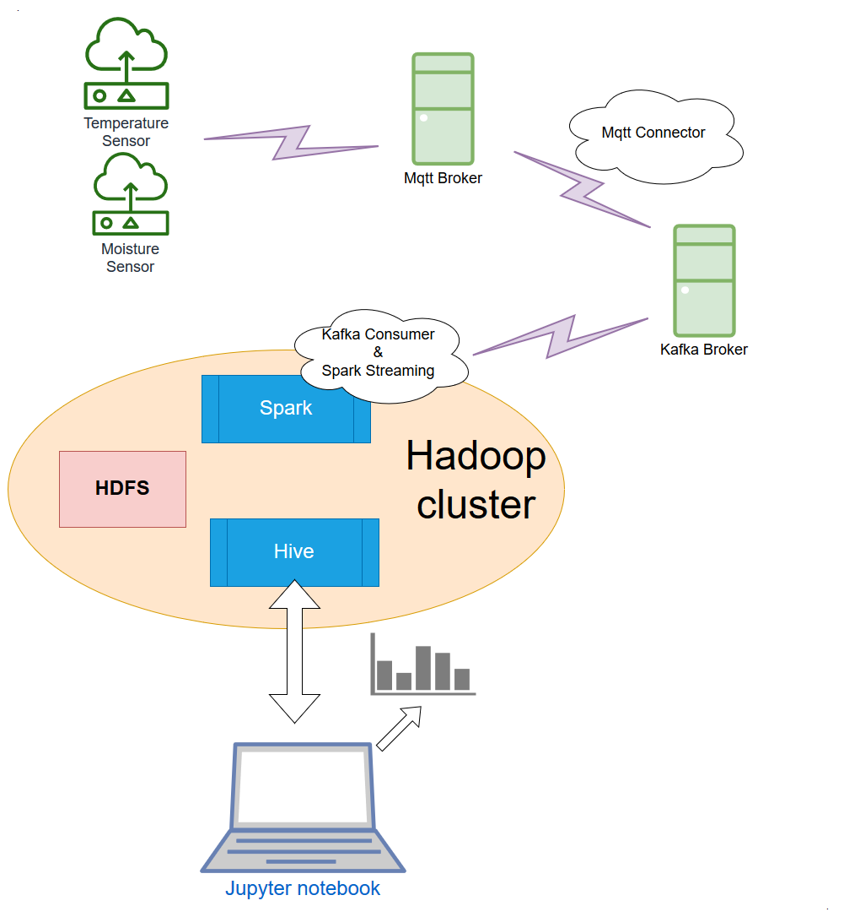
Solutions for IoT

Slide 9
Solutions for IoT
Why Hive?
Simple, light weight
Familiar, fast, scalable, and extensible
How to config?
PyHive
hive.server2.transport.mode=binary & hive.server2.thrift.port=10000
hive.server2.transport.mode=http & hive.server2.thrift.http.port=10001

Slide 10
Solutions for IoT
Why Jupyter?
open-source software
open-standards
services for interactive computing across 40 programming languages, including Python, R, Julia, and Scala
How to config?
Installing Jupyter using Anaconda
On Cloudera Quickstart: pyspark
Installing Jupyter with python pip

Slide 11
Live demonstration
System requirements:
+ Hadoop v2.9.2
+ Spark v2.11-2.4.0
+ Hive v2.3.4
+ Kafka broker
+ Mqtt broker
+ Jupyter notebook

Slide 12
Conclusion
The solution is quite simple but it can resolve the problem of large data increasement day by day of IoT
Once we have store the data in HDFS, we can analyze the data easily.
We can apply BI, ML to take the advantages of the huge data of IoT

Slide 13
References
Cloudera Quickstart VM: https://www.cloudera.com/downloads.html??utm_campaign=Download_sitelink&src=GoogleAdWords&gclid=Cj0KCQjwoInnBRDDARIsANBVyATE8Hl5CCfMLGunWSU0NzXXgagfl1g13jJMRslhZrtTaTNZuqY0DZwaAmeREALw_wcB
Cloudera - Ports Used by Components: https://www.cloudera.com/documentation/enterprise/5-2-x/topics/cdh_ig_ports_cdh5.html
Hive: https://hive.apache.org/index.html
Jupyter: https://jupyter.readthedocs.io/en/latest/index.html
Jupyter on Cloudera Quickstart: https://pathtoagi.wordpress.com/2017/07/28/clouderavm_jupyter_pyspark_setup/
Kafka: https://kafka.apache.org/
Matplotlib.pyplot – a MATLAB-like plotting framework: https://matplotlib.org/api/pyplot_api.html
Pandas – a Python Data Analysis Library: https://pandas.pydata.org/

Slide 14
Thank you all.

